Slide 1
Multiple Data Types (3주차)
Young-Gon Kim
DLI Instructor

Slide 2
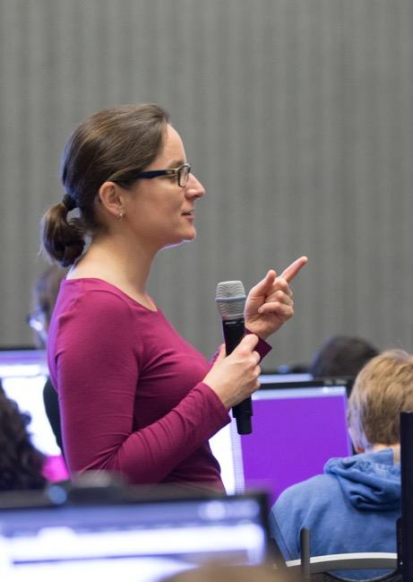
DEEP LEARNING INSTITUTE
DLI Mission
Helping people solve challenging problems using AI and deep learning.
Developers, data scientists and engineers
Self-driving cars, healthcare and robotics
Training, optimizing, and deploying deep neural networks
Notes:
People = Developers, Data Scientist, Engineers
Problems = Self-driving cars, healthcare issues like cancer detection, consumer services and robotics
AI / Deep Learning = training, optimizing and deploying deep neural networks

Slide 3
Week 2 Review
Image Captioning
Video Captioning
TOPICS

Slide 4
WEEK 2 REVIEW

Slide 5
IMAGE CAPTIONING

Slide 6
IMAGE CAPTIONING
Data / Network
Microsoft Common Object in Context (MS COCO)
Images
Five captions for each image
VGG16 Network
Visual Geometry Group
Notes:
MS COCO dataset을 통해 영상과 영상당 5개의 캡션정보를 읽어본다
캡셔닝을 위해 영상정보는 VGG16 network를 통해 추출하도록 한다

Slide 7
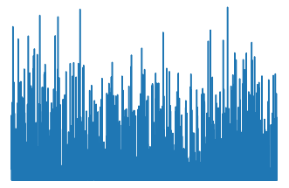
IMAGE CAPTIONING
Process
Import libraries
Evaluate data / Pixel to Content
Feature vector – FC7
Align captions with images
Will work with a subset of the data
Predict next word
Parse, tokenize, etc.
Notes:
Library를 load한다
Fully connected layer 7 (FC7)에 해당하는 feature값을 추출하여 영상정보의 feature 대표값으로 사용한다
Caption 데이터들을 이미지와 매칭시켜 학습하기 위해 정렬시킨다
결합된 두 정보를 활용하여 학습함으로써 이미지 캡셔닝을 수행한다

Slide 8
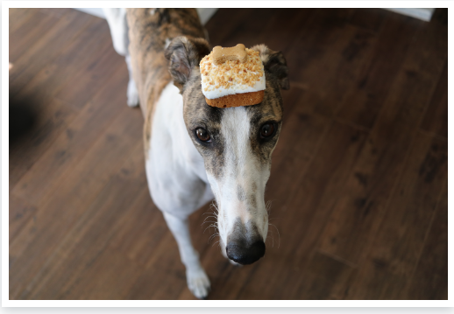
IMAGE CAPTIONING
a
[0.2,0.001,5e-2,….,0.2,0.9,0,0,0,0,0,0,0,0,0,0]
image | 0 | 0 | 0 | 0 | 0 | 0 | 0 | 0 | 0 | 0
a | 1 | 0 | 0 | 0 | 0 | 0 | 0 | 0 | 0 | 0
dog | 0 | 0 | 0 | 0 | 1 | 0 | 0 | 0 | 0 | 0
with | 0 | 0 | 0 | 1 | 0 | 0 | 0 | 0 | 0 | 0
cake | 0 | 0 | 1 | 0 | 0 | 0 | 0 | 0 | 0 | 0
Input
W
Recurrent layer
h(t)
Output
[1,0,0,0,0,0,0,0,0,0]
a
Notes:
영상정보에 caption정보를 주는 방법

Slide 9
IMAGE CAPTIONING
Process
Architecture the network (RNN)
Train / build model
Evaluate a training image & captions
Generate a caption for a validation image
RUN LAST CODE BLOCK TO FREE GPU MEMORY

Slide 10
IMAGE CAPTIONING
Convolution
ReLU
Pooling
Convolution
ReLU
Pooling
Convolution
ReLU
Pooling
Convolution
ReLU
Pooling
Convolution
ReLU
Fully Connected Layers
Prediction
X
a | 1 | 0 | 0 | 0 | 0 | 0 | 0 | 0 | 0 | 0
cat | 0 | 0 | 0 | 0 | 1 | 0 | 0 | 0 | 0 | 0
is | 0 | 0 | 0 | 1 | 0 | 0 | 0 | 0 | 0 | 0
on | 0 | 0 | 1 | 0 | 0 | 0 | 0 | 0 | 0 | 0
the | 0 | 1 | 0 | 0 | 0 | 0 | 0 | 0 | 0 | 0
grass | 0 | 0 | 0 | 0 | 0 | 0 | 0 | 0 | 1 | 0
Generic Schematic of the Modified Reference CNN Architecture CaffeNet with two LSTM Layers
Embedded Sentence
https://arxiv.org/pdf/1411.4389.pdf
LSTM Layers

Slide 11
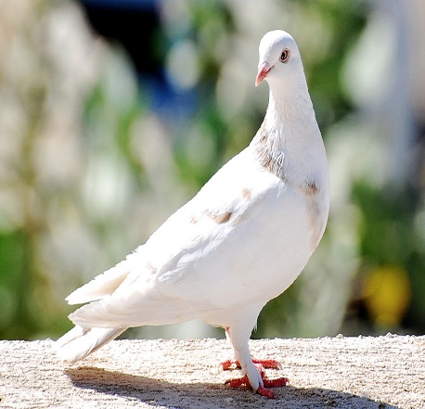
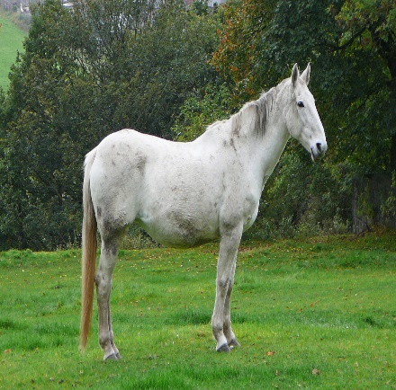
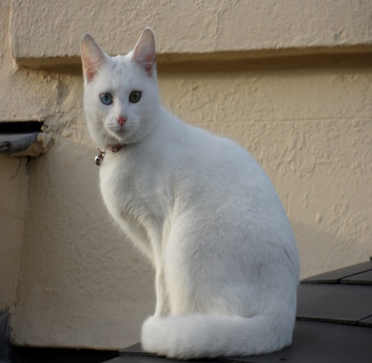
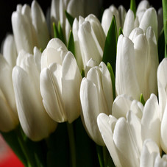
IMAGE CAPTIONING
Results
CaffeNet | A white bird standing on top of a sandy beach.
VGG | A small bird standing on the ground.
CaffeNet | A white horse standing in a lush field of grass.
VGG | A white horse standing in a field next to a fence.
CaffeNet | A white cat sitting on a chair.
VGG | A white and white cat laying on a white chair.
CaffeNet | A bunch of bananas that are on a table.
VGG | A close up of a bunch of white flowers.
https://arxiv.org/pdf/1411.4389.pdf

Slide 12
VIDEO CAPTIONING

Slide 13
VIDEO CAPTIONING
Data / Network
Microsoft Research Video Description Corpus (MSVD)
About 2,000 video clips
Ten captions for each video
VGG16 Network
Visual Geometry Group

Slide 14
VIDEO CAPTIONING
Process
Import libraries
Evaluate videos and captions
Create a mean vector of a single clip
This will generate a high-level representation of each frame from layer fc7
Align captions with feature maps
Will work with a subset of the data
Predict next word for captions
Parse, tokenize, etc.

Slide 15
VIDEO CAPTIONING
Process
Architect the network (RNN)
NOTE: Troubleshooting wording before running code block
Train / build model
NOTE: Troubleshooting wording before running code block
Evaluate a training image & captions
Generate a caption for a validation image

Slide 16
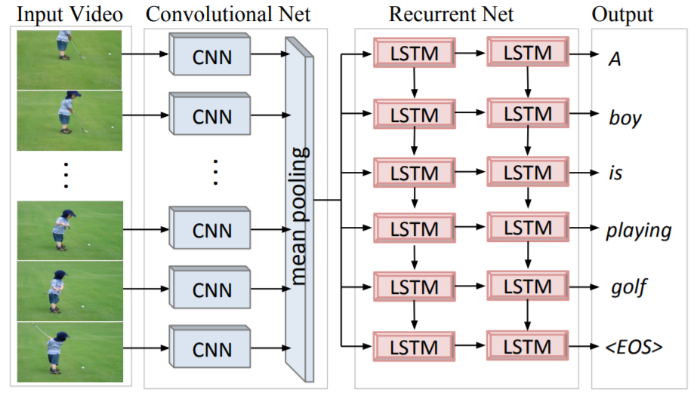
VIDEO CAPTIONING
Prediction
1 | 0 | 0 | 0 | 0 | 0 | 0 | 0 | 0 | 0
0 | 0 | 0 | 0 | 1 | 0 | 0 | 0 | 0 | 0
0 | 0 | 0 | 1 | 0 | 0 | 0 | 0 | 0 | 0
0 | 0 | 1 | 0 | 0 | 0 | 0 | 0 | 0 | 0
0 | 1 | 0 | 0 | 0 | 0 | 0 | 0 | 0 | 0
0 | 0 | 0 | 0 | 0 | 0 | 0 | 0 | 0 | 1
https://arxiv.org/pdf/1412.4729.pdf

Slide 17
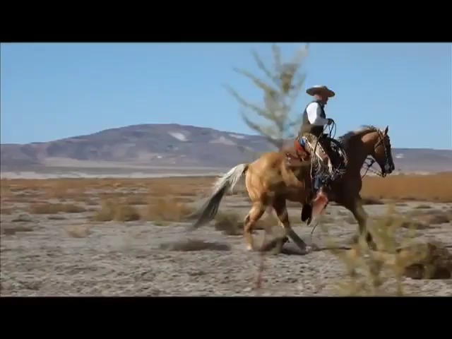
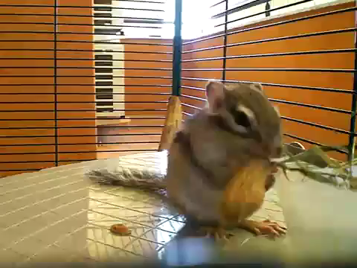
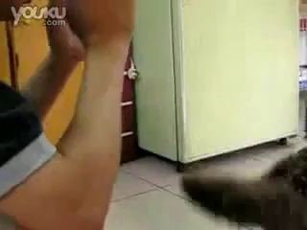
VIDEO CAPTIONING
Results
A man is riding a horse
A animal is eating
A dog is standing
https://arxiv.org/pdf/1412.4729.pdf
https://www.aclweb.org/anthology/P11-1020.pdf

Slide 18
Reference
https://arxiv.org/pdf/1411.4389.pdf
https://arxiv.org/pdf/1412.4729.pdf
https://www.aclweb.org/anthology/P11-1020.pdf

